Slide 1
Angular Workshop
Ngô Hùng Phúc

Slide 2
Introduction
Versions of Anguar: Lastest Angular 7
Language using: Typescript
Selecting an Editor: VS Code (recommend)
Setting up Our Environment: NodeJS, Angular CLI, TS lint, cmder, dotnet core, VS 2019, SQL Server
What We'll Be Building: SPA (Single page application) power by .Net Core as back end
Overview of Angular: Angular is a platform and framework for building client applications in HTML and TypeScript. Angular is written in TypeScript. It implements core and optional functionality as a set of TypeScript libraries that you import into your apps.

Slide 3
Introduction to Typescript
Install npm install -g typescript, tslint
Compile TS tsc typescript-file
Let: avoid using variable before declare
let hello = "Hello!";
Const: just like let but we cant reassign value
const numLivesForCat = 9;
Readonly Read-only members can be accessed outside the class, but their value cannot be changed. Since read-only members cannot be changed outside the class, they either need to be initialized at declaration or initialized inside the class constructor.
Notes:
https://www.typescriptlang.org/docs/handbook/variable-declarations.html

Slide 4
Basic types in typescript
Boolean let isDone: boolean = false;
Number let decimal: number = 6;
String let color: string = "blue";
Array let list: number[] = [1, 2, 3];
Tuple let x: [string, number]; x = ["hello", 10];
Enum enum Color {Red = 1, Green, Blue}
Any let notSure: any = 4;
Void function warnUser(): void
Null and Undefined
Object
Type assertion let strLength: number = (someValue as string).length;

Slide 5
Typescript function
Arrow Function: Fat arrow notations are used for anonymous functions i.e for function expressions
let sum = (x: number, y: number) => x + y;
Function Overloading: You can have multiple functions with the same name but different parameter types and return type. However, the number of parameters should be the same.
function add(a:string, b:string):string;
function add(a:number, b:number): number;
Rest Parameters
function Greet(greeting: string, ...names: string[]) {
return greeting + " " + names.join(", ") + "!";
}
Greet("Hello", "Steve", "Bill"); // returns "Hello Steve, Bill!"

Slide 6
Speread operator
var parts = ['shoulders', 'knees'];
var lyrics = ['head', ...parts, 'and', 'toes'];
// ["head", "shoulders", "knees", "and", "toes"]

Slide 7
Static and dynamic typing
Dynamic typing — the type is associated with the value, and checked at run-time.
function g( a ) {
return a / 10;
}
Static typing — type is associated with variable or textual expression, and checked at compile-time.
function g( a : number ) : number{
return a / 10;
}

Slide 8
OOP
Interface
interface KeyPair {
key: number;
value: string;
}
let kv1: KeyPair = { key:1, value:"Steve" };

Slide 9
OOP
Class A class can include the following:
Constructor
Properties
Methods
Abstract classes: are mainly for inheritance where other classes may derive from them

Slide 10
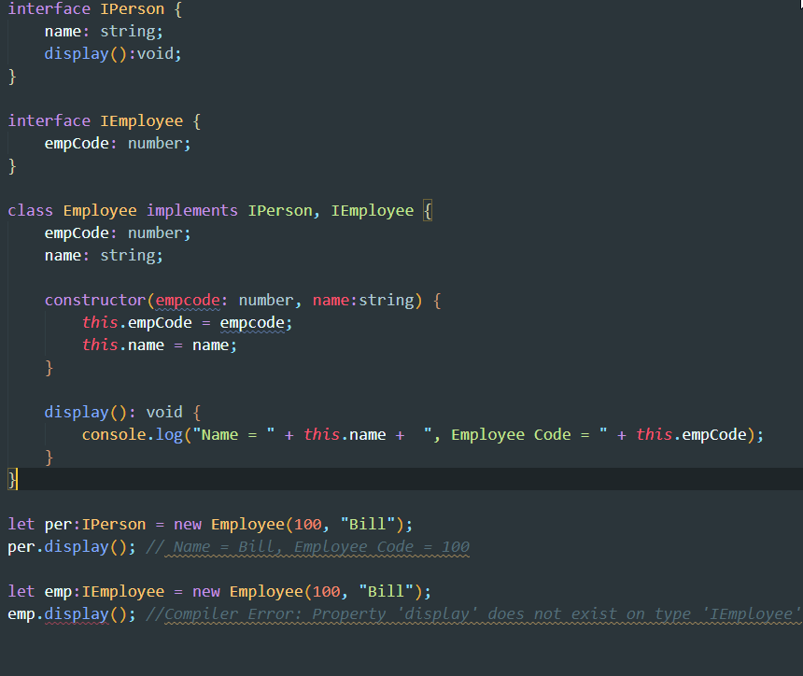

Slide 11
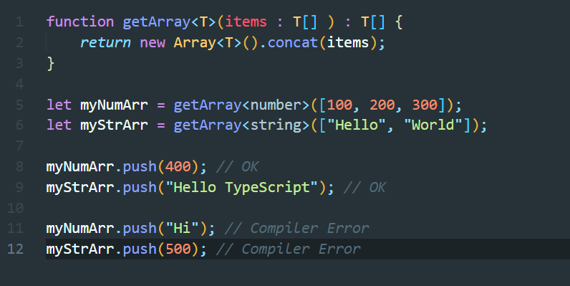
TypeScript - Generic
Generics offer a way to create reusable components or services. Generics provide a way to make components work with any data type and not restrict to one data type. So, components can be called or used with a variety of data types.

Slide 12
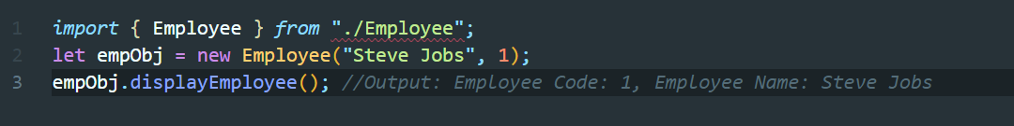
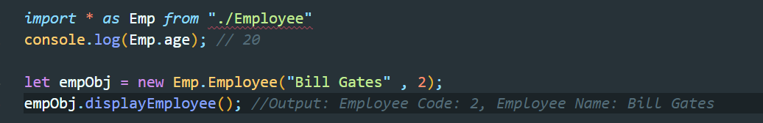
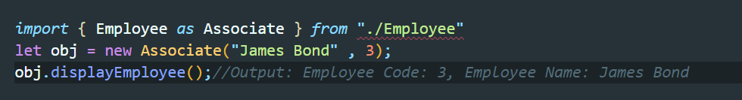
TypeScript - Module
Importing a Single export from a Module:
Importing the Entire Module into a Variable
Renaming an Export from a Module:

Slide 13
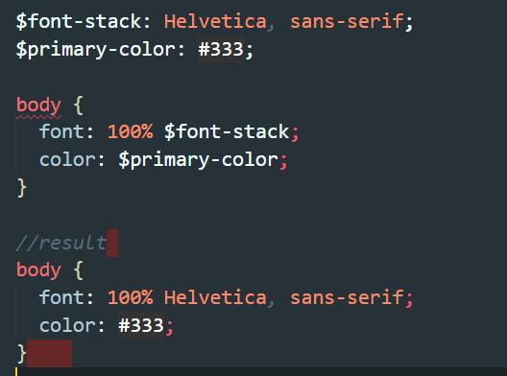
Benefit of SASS

Slide 14
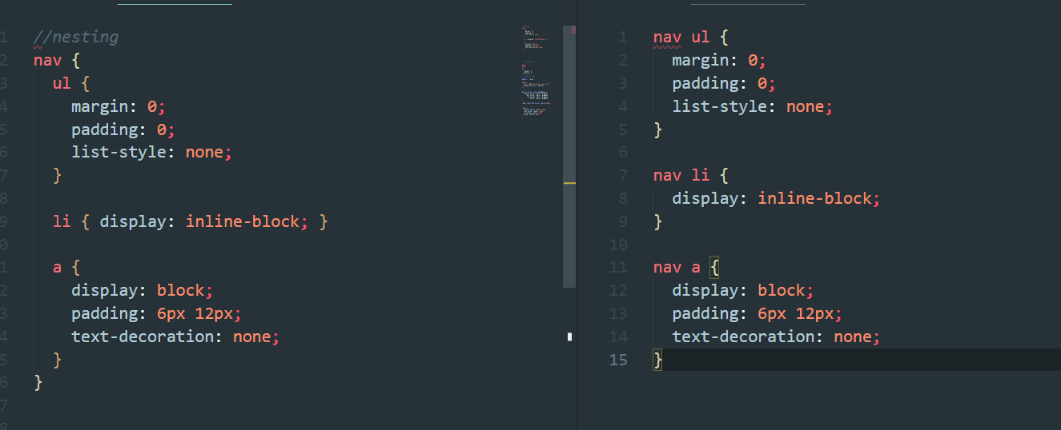
Benefit of SASS

Slide 15
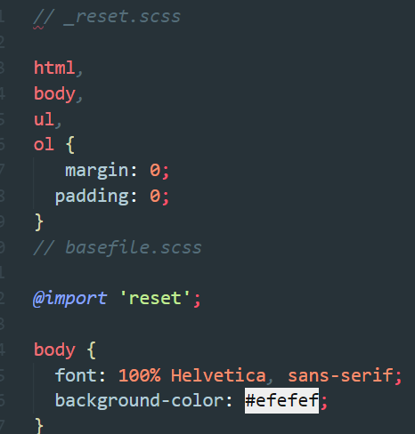
Benefit of SASS

Slide 16
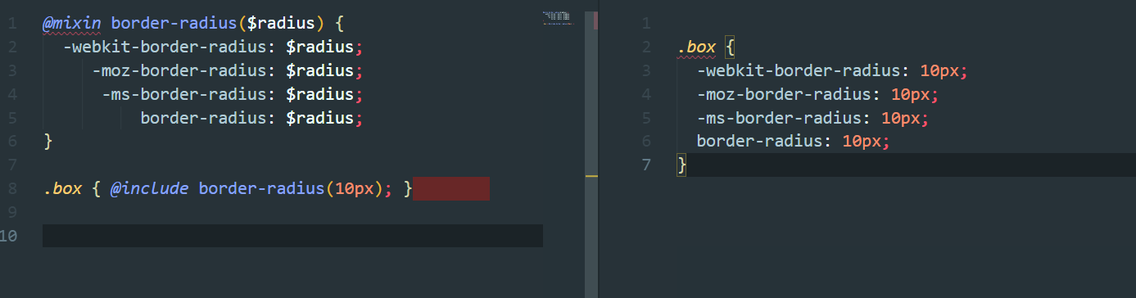
Benefit of SASS

Slide 17
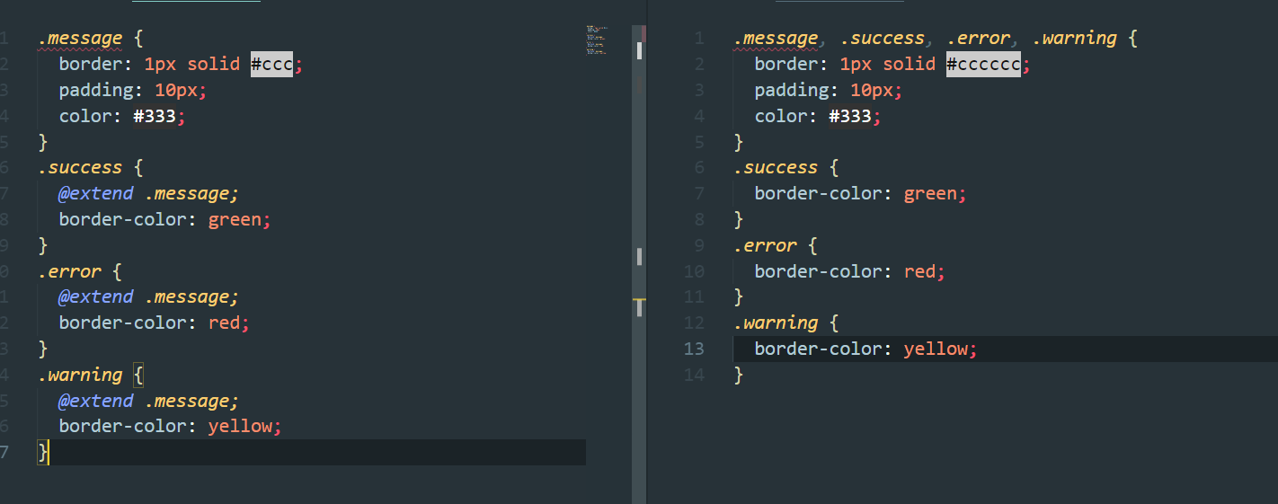
Benefit of SASS

Slide 18
Architecture overview
NgModules: basic building blocks of an Angular application an Angular app is defined by a set of NgModules. An app always has at least a root module which provides the bootstrap mechanism that launches the application. and has many more feature modules.
Some import properties of @NgModules:
declarations — Components, Directives, and Pipes that belong to the NgModule
exports — the subset of declarations that should be visible and usable in the Components of other NgModules
imports — other modules whose exported classes are needed by Components declared in the NgModule
providers — list of the needed Services that, because they are listed here, become are available app-wide
bootstrap — the main application View, called the Root Component, which hosts all other app views. (only the Root Module should set this bootstrap property)

Slide 19
Architecture overview
Components: A Component controls a screen called a View. The logic of a Component is defined inside a class. Angular creates, updates, and destroys Components as the user moves through the application.
A Component is identified by the “@Component” decorator that has a set of properties. The most import properties are the following ones:
selector — tells how the component is referenced in HTML; in simple words, it corresponds to the HTML tag.
templateUrl — gives the path of the HTML template.
providers — an array of Dependency Injection Providers for Services that the Component requires.

Slide 20
Architecture overview
Services: we should create a Service when two or more Components or other things need to access the same data or if we want to encapsulate interactions with a web server or if we want to define how to validate user inputs.
Service are stateless and Singletons.
Service is defined using @Injectable decorator.

Slide 21
Architecture overview
Dependency Injection: DI is Design Pattern in which one or more dependencies (Services) are injected into a dependent object
A Provider is a recipe for creating a dependency. We must at least register one Provider of any Service we want to use. It can be done in Modules or in Components. Doing this in a Module allows Angular to inject the corresponding Services in any class it creates and so the Service instance lives for the life of the app.

Slide 22
Architecture overview
Data Binding
There are two types of data binding:
Event binding lets your app respond to user input in the target environment by updating your application data.
Property binding lets you interpolate values that are computed from your application data into the HTML.

Slide 23
Architecture overview
Input and Output: Input properties usually receive data values. Output properties expose Event producers.
To define Input and Output use @Input & @Output decorator

Slide 24
Architecture overview
Directives: In Angular, there are three kinds of Directives:
Components — Directives with a template
Structural Directives — change the DOM layout by adding and removing DOM elements
Attribute Directives — change the appearance or behavior of an element, Component, or another Directive
Structural Directives change the structure of the View. They are things like “NgFor” or “NgIf ”
Attribute Directives are used as attributes of elements. They are things like “NgClass” or “NgStyle”

Slide 25
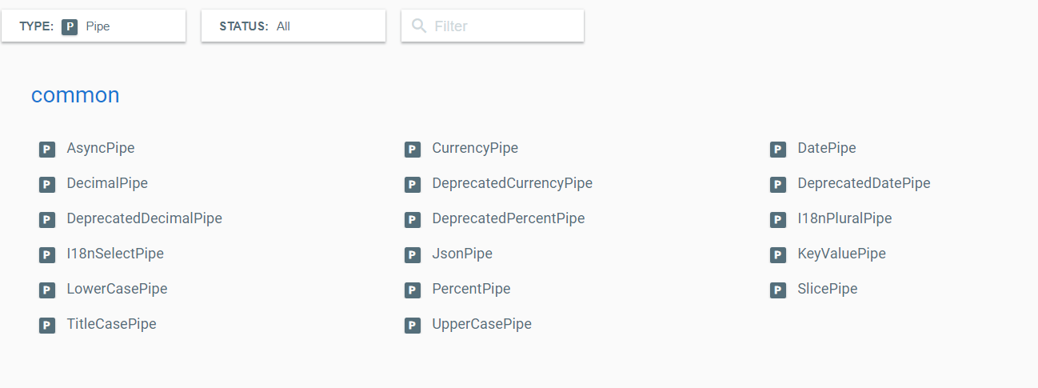
Architecture overview
Pipes: Pipes are a way to operate some transformations over data before displaying them. Angular comes with several built-in Pipes
We are also able to create our own Pipes by using the “@Pipe” decorator

Slide 26
Architecture overview
Routing & Navigation: the Router allows navigation from one View to the next.
To use router we need to import RouterModule in module

Slide 27
Getting Started
SASS is a CSS preprocessor, which adds special features such as variables, nested rules and mixins (sometimes referred to as syntactic sugar) into regular CSS
Benefit of SASS
Variables
Nesting
Partial Import
Mixins
Extend/Inheritance

Slide 28
Setting up an Angular Application
New project ng new my-first-project
Run project ng serve
Build ng build
Lint ng lint
Test ng test
E2e ng e2e
Generate ng g

Slide 29
List of support command when using ng g
appShell
application
class
component
directive
enum
guard
interface
library
module
pipe
service
serviceWorker
universal

Slide 30
Introduction to ES Modules
Modules allow us to encapsulate all sort of functionality and expose these functionality to other JS file as libraries
Syntax:
import package from 'module-name‘
Or
import * as lib from 'lib';
Example:
import React, { Component } from 'react'
React here is default export and { Component } non-default export

Slide 31
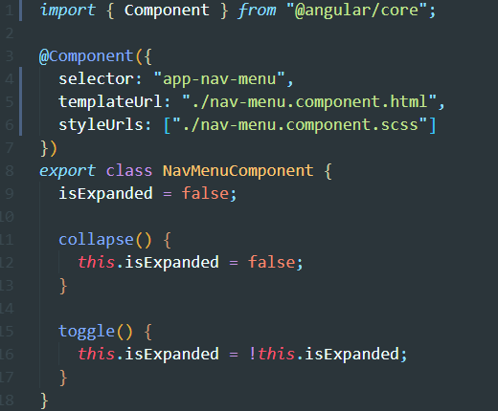
Introduction to Component
You define a component's application logic—what it does to support the view—inside a class. The class interacts with the view through an API of properties and methods.
The @Component decorator identifies the class immediately below it as a component class

Slide 32
Create Dynamic components
To create dynamic component we need to use ViewContainerRef to reference the container element we want to display. ViewContainerRef contain method to create a delete component. Then use ComponentFactoryResolver to create component factory.
Step to create a dynamic component
Clear the container.
Create a factory for component.
Create a component using the factory.
Pass the value for @Input properties using a component reference instance method.

Slide 33
Binding with Interpolation
Interpolation allows you to display data from your component into view or even do some logic to display your data
Interpolation refers to embedding expressions into marked up text.
By default, interpolation uses as its delimiter the double curly braces {{ and }}.

Slide 34
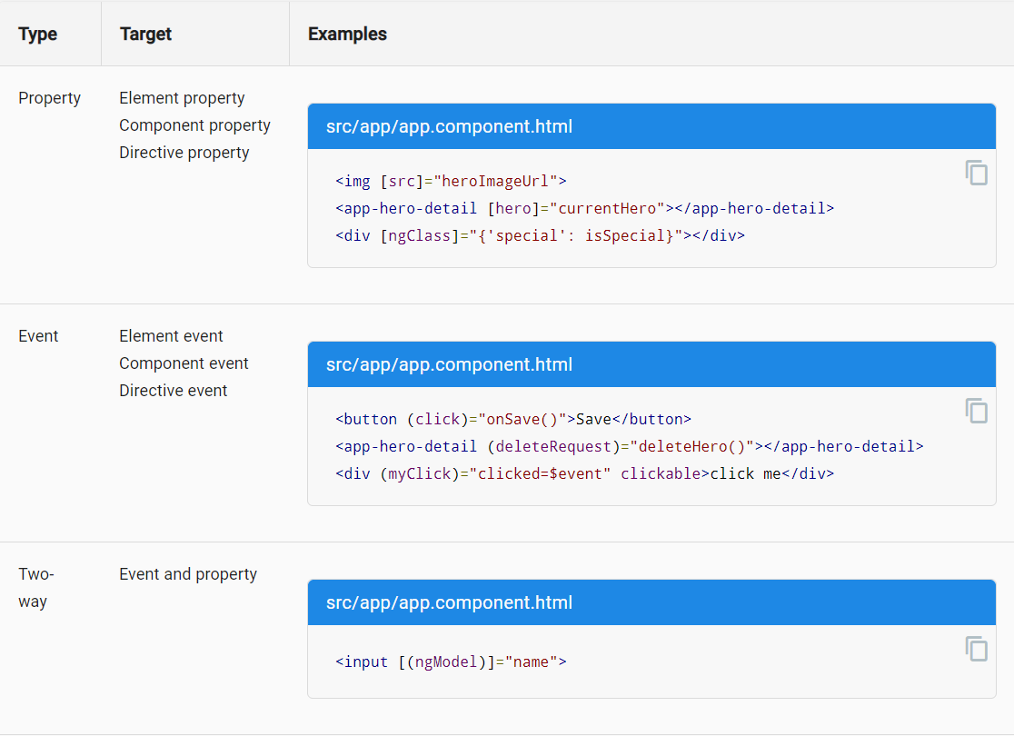
6 bindings type

Slide 35
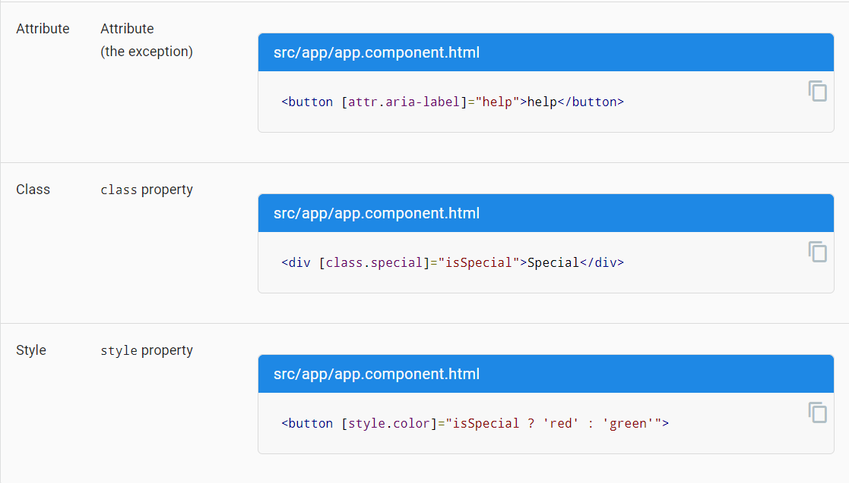

Slide 36
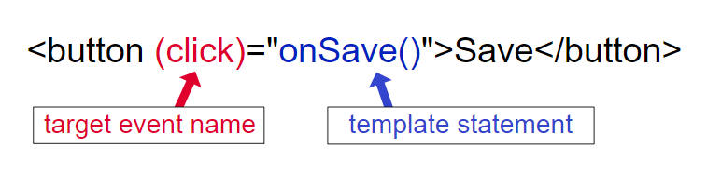
Handling Events with Event Binding
Event binding allows you to listen for certain events such as keystrokes, mouse movements, clicks, and touches
Example

Slide 37

Handling Input with Two-way Binding
You often want to both display a data property and update that property when the user makes changes.
On the element side that takes a combination of setting a specific element property and listening for an element change event.

Slide 38
Introduction to Directives
There are four types of directives in Angular,
Components directives
Structural directives: Structural directives are responsible for HTML layout. They shape or reshape the DOM's structure, typically by adding, removing, or manipulating elements.
Attribute directives: An Attribute directive changes the appearance or behavior of a DOM element.
Custom Directive

Slide 39
Directives overview
Structural Directives change the structure of the view. Structural directives are responsible for HTML layout. They shape or reshape the DOM's structure, typically by adding, removing, or manipulating elements.
Structural directives are easy to recognize. An asterisk (*) precedes the directive attribute name as in this example. Three of the common, built-in structural directives—ngIf, ngFor, and ngSwitch...
Attribute directives are used as attributes of elements. ngClass or ngStyle are Attribute directives

Slide 40
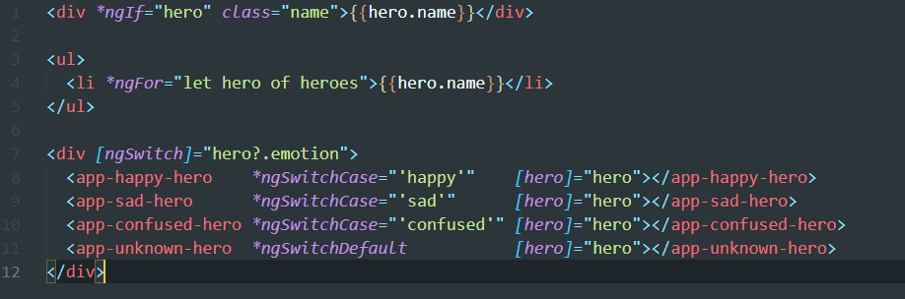
Structural directives example

Slide 41
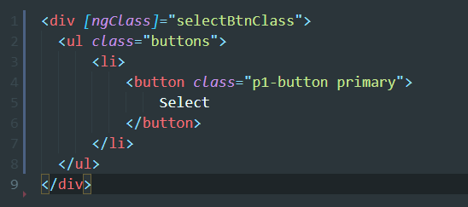
Attribute directives

Slide 42
PIPE
Every application starts out with what seems like a simple task: get data, transform them, and show them to users. Pipe simply transform your data into any form you want like date, currency, time

Slide 43
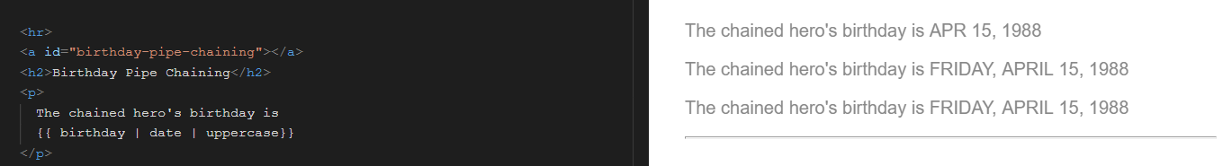
Transforming Data with Pipes
Every application starts out with what seems like a simple task: get data, transform them, and show them to users

Slide 44
Async pipe
The async pipe is a pipe that either waits for a promise to resolve to display data or subscribes to an observable to display the emitted values. The component doesn't have to subscribe to the async data source, extract the resolved values and expose them for binding, and have to unsubscribe when it's destroyed (a potent source of memory leaks)
<h2 *ngIf="!countCompleted">{{ count$ | async }}</h2>
Notes:
https://angular-fjw7ux.stackblitz.io

Slide 45
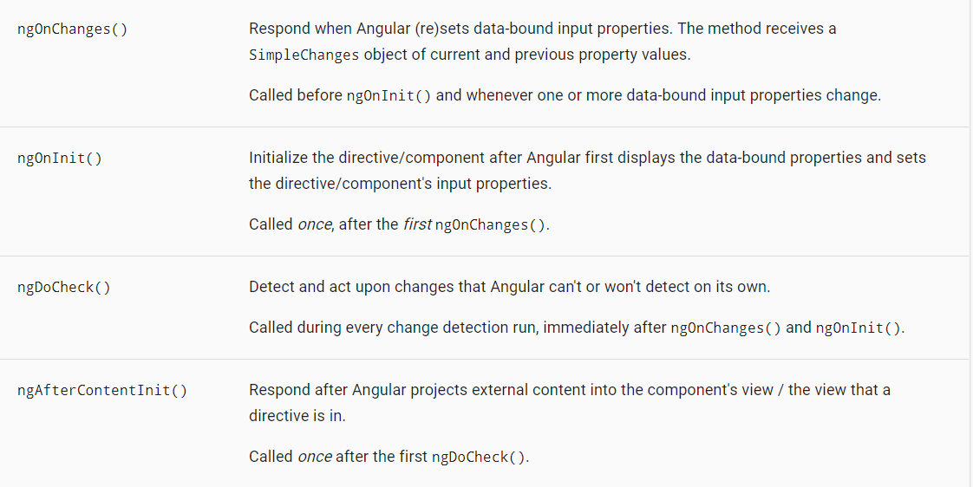
Angular lifecycle

Slide 46
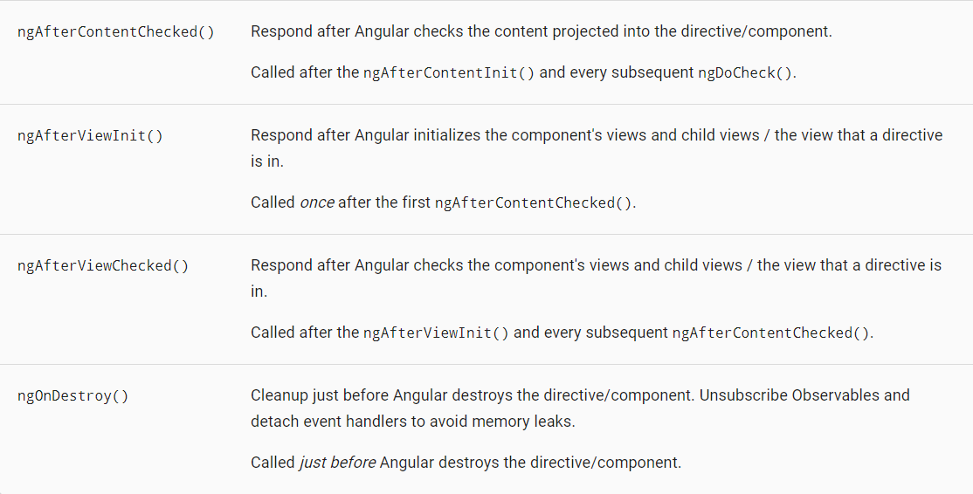

Slide 47
Angular form
There is 2 way to build form in angular
Template driven forms using FormsModule
Reactive forms using ReactiveFormsModule

Slide 48
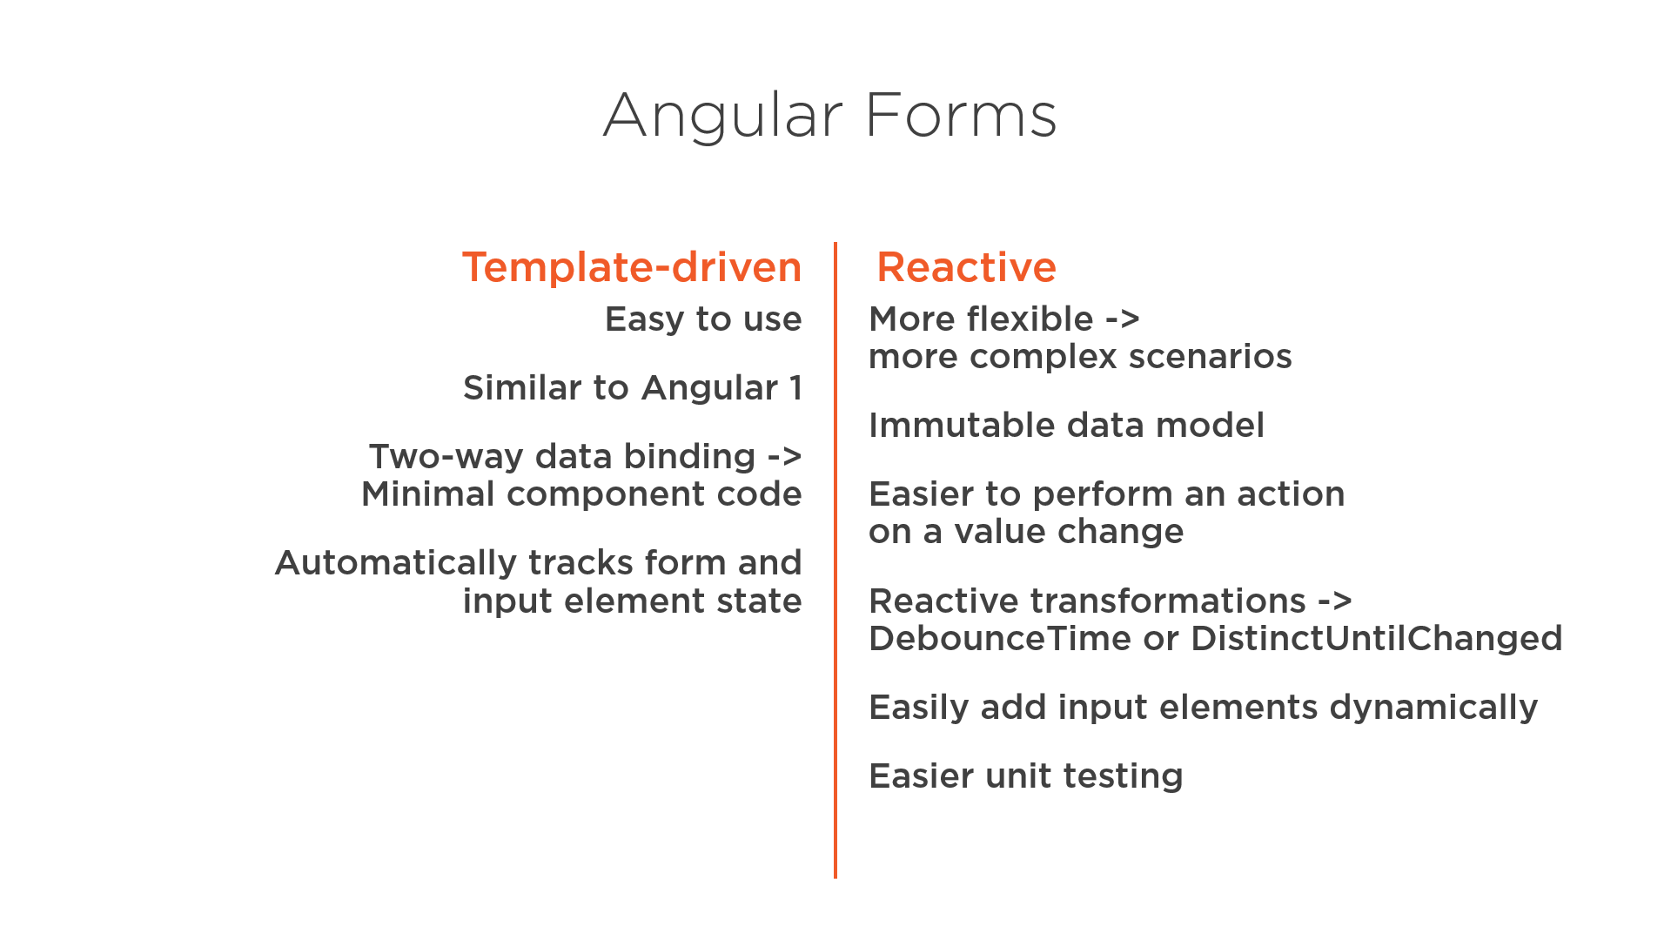
Compare

Slide 49
Types of Feature Modules
There are five general categories of feature modules which tend to fall into the following groups:
Domain feature modules.
Routed feature modules.
Routing modules.
Service feature modules.
Widget feature modules.
Read more at https://angular.io/guide/module-types

Slide 50
Routing & Navigation
The Angular Router enables navigation from one view to the next as users perform application tasks.
Syntax
Router imports import { RouterModule, Routes } from '@angular/router’;
Imports RouterModule.forRoot(routes, { enableTracing: true })

Slide 51
Router components
The RouterOutlet is a directive from the router library that is used like a component. It acts as a placeholder that marks the spot in the template where the router should display the components for that outlet.
<router-outlet></router-outlet>
Router links help user to navigate between pages
<a routerLink="/heroes" routerLinkActive="active">Heroes</a>
Active router links: The RouterLinkActive directive toggles css classes for active RouterLink bindings based on the current RouterState.

Slide 52
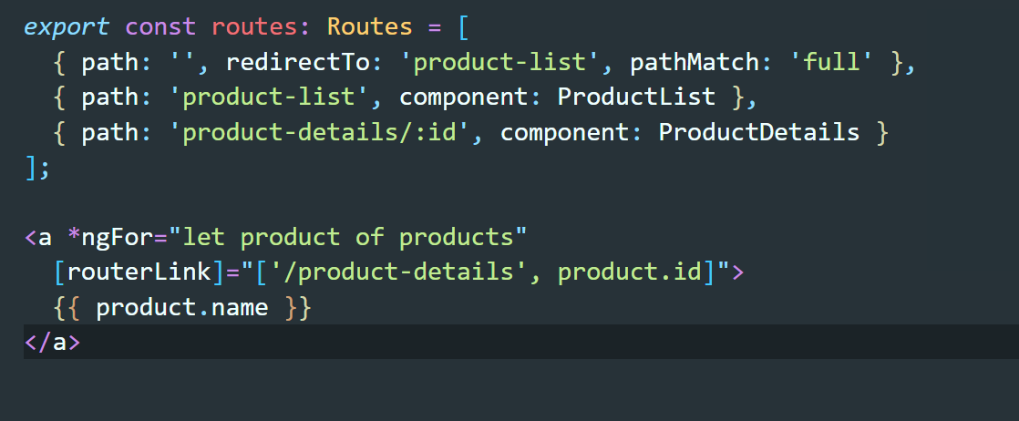
Sending and Receiving Route Parameters

Slide 53
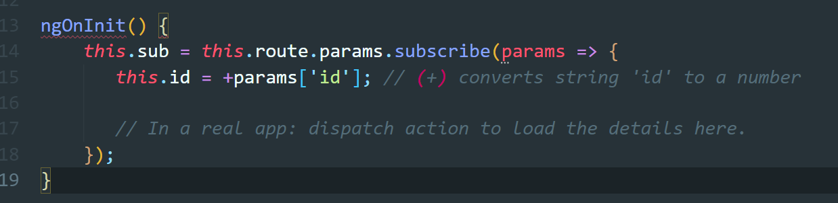
Subscribing to Route Parameters

Slide 54
Route Guards
Some use case when we should use guard
Perhaps the user is not authorized to navigate to the target component.
Maybe the user must login (authenticate) first.
Maybe you should fetch some data before you display the target component.
You might want to save pending changes before leaving a component.
You might ask the user if it's OK to discard pending changes rather than save them.
You add guards to the route configuration to handle these scenarios.
A guard's return value controls the router's behavior:
If it returns true, the navigation process continues.
If it returns false, the navigation process stops and the user stays put.
If it returns a UrlTree, the current navigation cancels and a new navigation is initiated to the UrlTree returned.

Slide 55
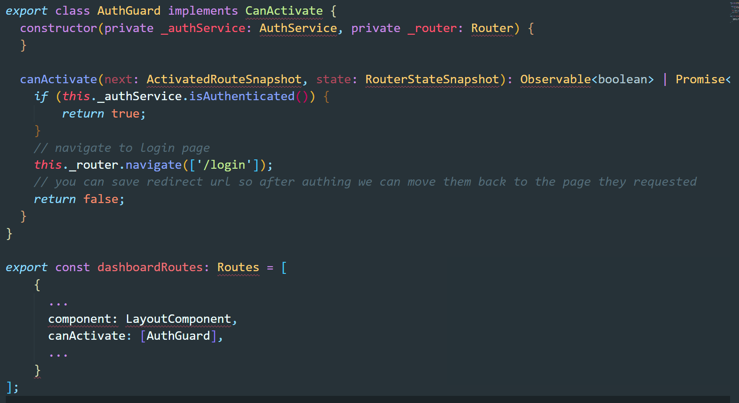
Route Guards

Slide 56
CanActivate Interface
Interface that a class can implement to be a guard deciding if a route can be activated. If all guards return true, navigation will continue. If any guard returns false, navigation will be cancelled. If any guard returns a UrlTree, current navigation will be cancelled and a new navigation will be kicked off to the UrlTree returned from the guard

Slide 57
CanDeactivate Interface
Interface that a class can implement to be a guard deciding if a route can be deactivated. If all guards return true, navigation will continue. If any guard returns false, navigation will be cancelled. If any guard returns a UrlTree, current navigation will be cancelled and a new navigation will be kicked off to the UrlTree returned from the guard.
Example
https://stackblitz.com/edit/candeactivate
https://stackblitz.com/edit/clabnet-angular-candeactivate

Slide 58
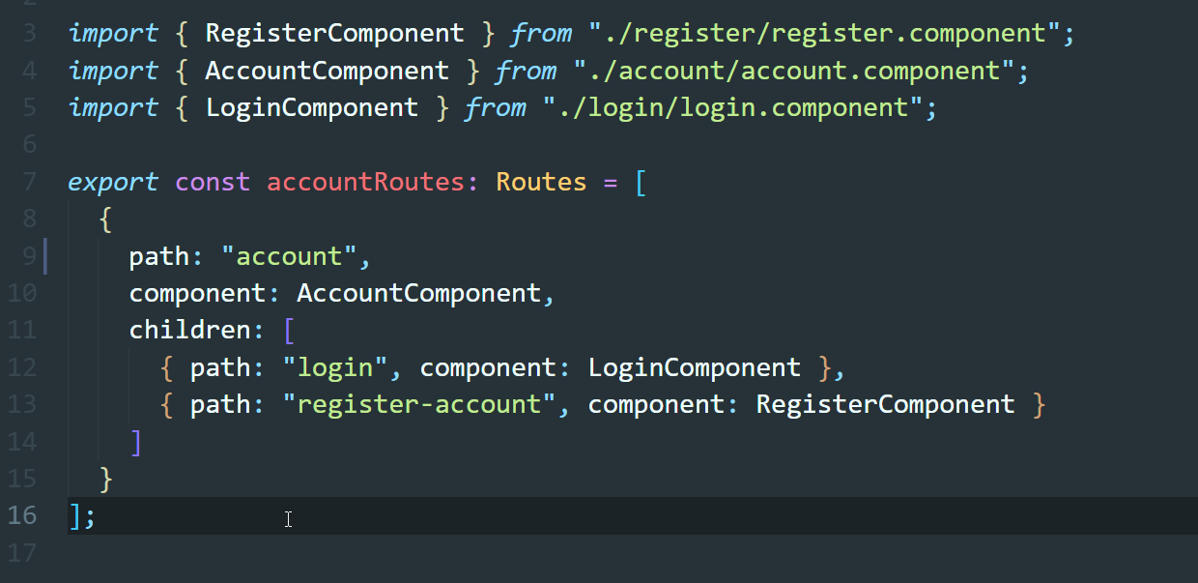
Define Child Routes

Slide 59
RxJs and HTTP
You define a function for publishing values, but it is not executed until a consumer subscribes to it. The subscribed consumer then receives notifications until the function completes, or until they unsubscribe.
Notes:
https://www.youtube.com/watch?v=XbOuCBuQepI

Slide 60
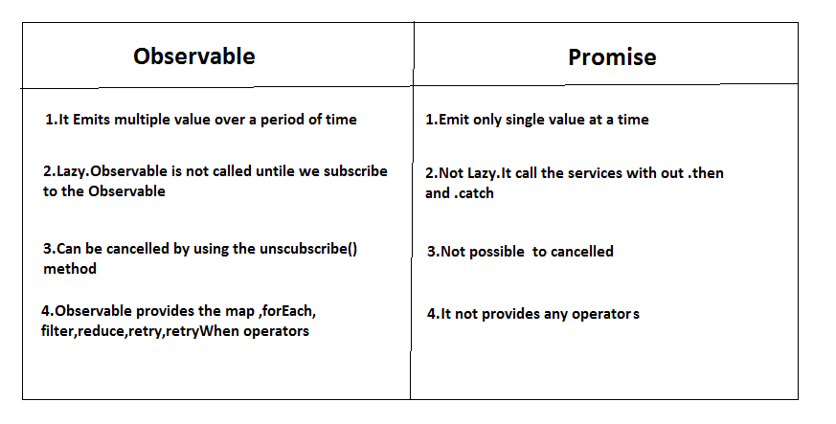
Different between promises and observable

Slide 61
Async Pipe
The async pipe subscribes to an Observable or Promise and returns the latest value it has emitted. When a new value is emitted, the async pipe marks the component to be checked for changes. When the component gets destroyed, the async pipe unsubscribes automatically to avoid potential memory leaks.
Example: https://stackblitz.com/github/codecraft-tv/angular-course/tree/current/8.pipes/3.async-pipe/code

Slide 62
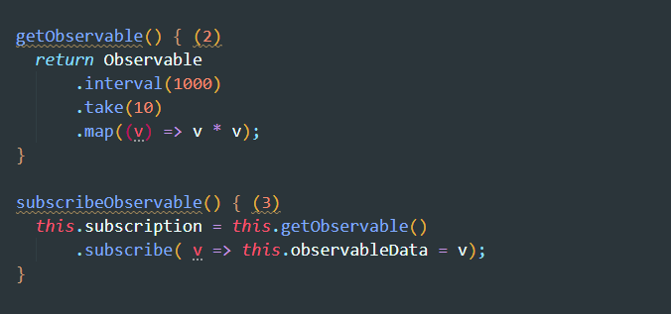
Subscribing to an Observable

Slide 63
Using Http in Angular
Most front-end applications communicate with backend services over the HTTP protocol. Modern browsers support two different APIs for making HTTP requests: the XMLHttpRequest interface and the fetch() API.
The HttpClient in @angular/common/http offers a simplified client HTTP API for Angular applications that rests on the XMLHttpRequest interface exposed by browsers.
To use HTTP we need to import
For module import { HttpClientModule } from '@angular/common/http';
For component or service import { HttpClient } from '@angular/common/http';

Slide 64
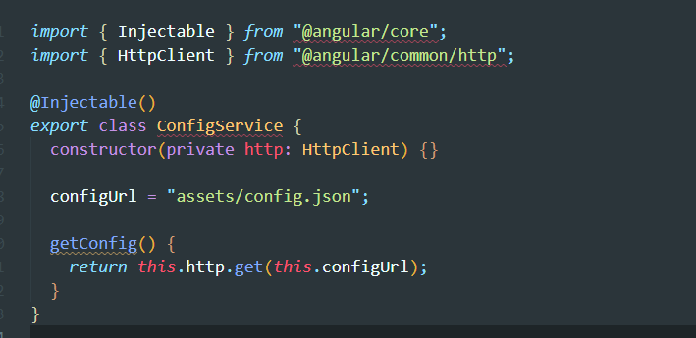
Sending an HTTP Request

Slide 65
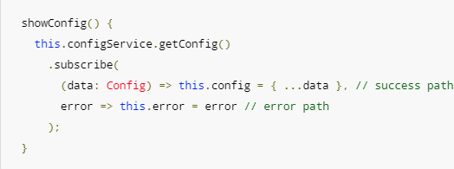
HTTP Exception Handling

Slide 66
Communicating Between Components
Dumb Components
Dumb components are also called ‘presentational’ components because their only responsibility is to present something to the DOM
Smart Components
Smart components (or container components) on the other hand have a different responsibility. Because they have the burden of being smart, they are the ones that keep track of state and care about how the app works.

Slide 67
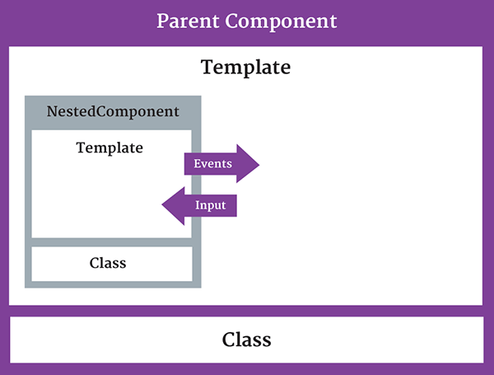
Building a Nested Component
Notes:
https://stackblitz.com/github/codecraft-tv/angular-course/tree/current/1.quickstart/8.nesting-components-and-inputs/code

Slide 68
Input and OUtput
First of all, the idea of Input and Output is to exchange data between components. They are a mechanism to send/receive data from one component to another.
Input is used to receive data in whereas Output is used to send data out. Output sends data out by exposing event producers, usually EventEmitter objects.
https://stackblitz.com/edit/input-output-angular

Slide 69
Viewchild
Want to get access to a child component, directive or a DOM element from a parent component class? It’s easy to do with the ViewChild decorator. ViewChild returns the first element that matches a given component, directive or template reference selector.
Notes:
https://alligator.io/angular/viewchild-access-component/

Slide 70
State management with ngrx
A state management library for Angular applications inspired by Redux. By using this library we are able to keep the current state of the app in one place — the store. This enables us to use the store as a single source of truth meaning we can reliably access the state of the app from this one place rather than components of the app holding their own state and having to communicate and pass data between them. This reduces the communication between components which is particularly helpful to scale our app without adding more complexity.

Slide 71
Benefit of NgRX
Single source of truth (1 store only)
Local cache of data
Render item instantly
Avoid round trip to API
Scalable for large app

Slide 72
Core Concept of ngrx
We can’t mutate the application state. State is immutable.
Actions describe state changes.
State mutation can only be done by dispatching Actions.
Changes are made with pure functions.
Reducer are capable of changing Application State.
Pure functions called reducers take the previous state and the next action to compute the new state.
Pure function is a function which:
Given the same input, will return same output
Produces no side effects

Slide 73
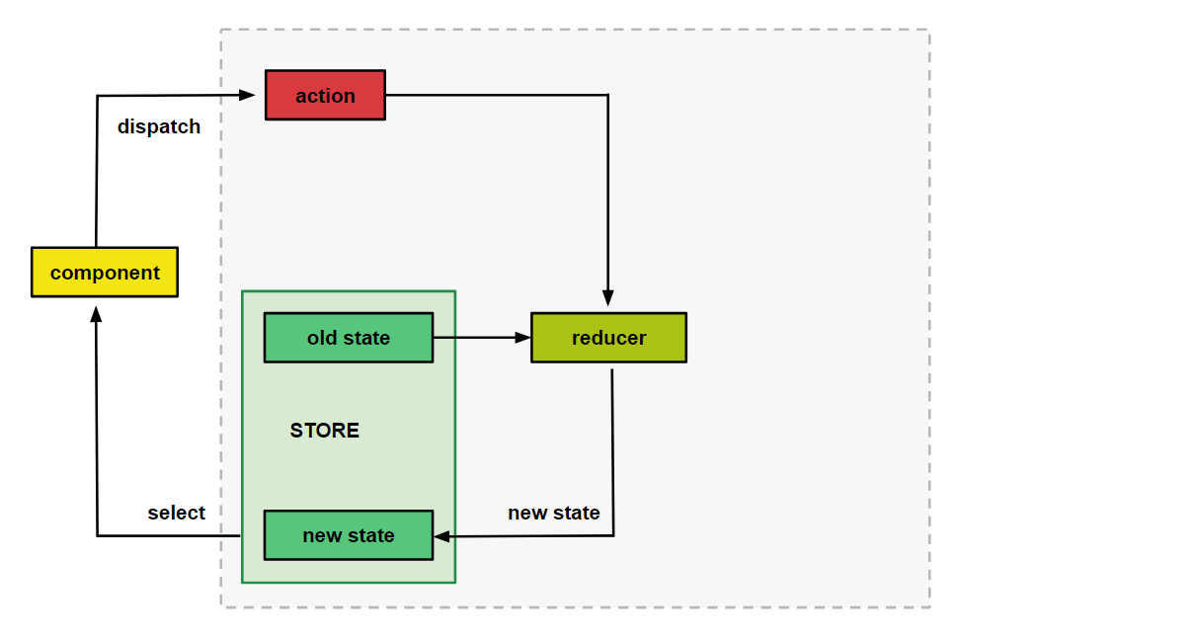
Redux architecture

Slide 74
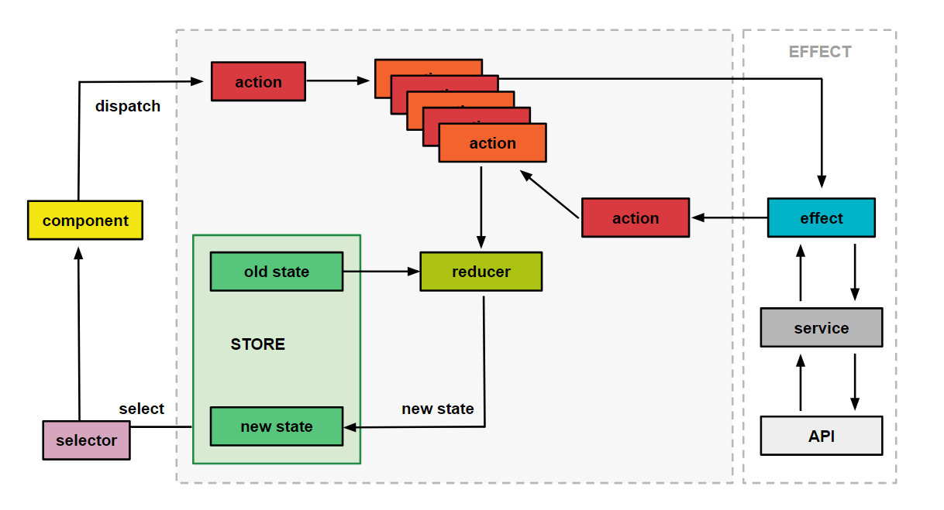
NGRX architecture

Slide 75
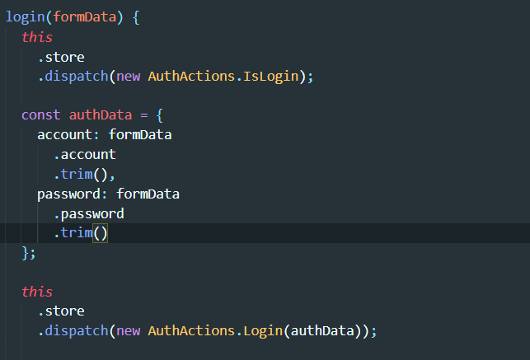
Action in ngrx
The action describes the change in state that is to be made.
Dispatch action use to send action types and payload to reducer to calculate new state

Slide 76
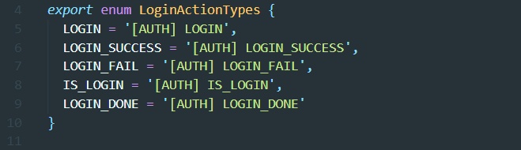
Action types in ngrx
Action types is just a string that describe how state in application change

Slide 77
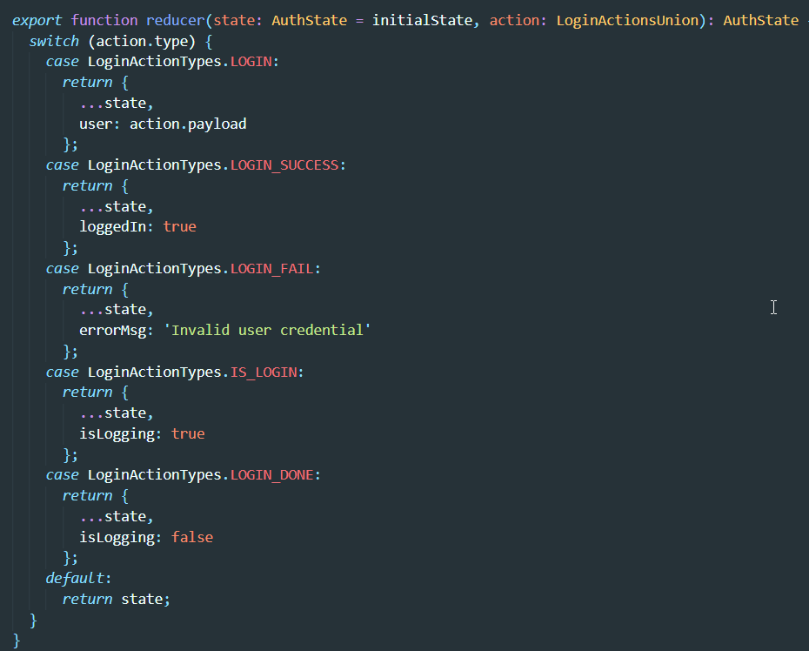
Reducer in ngrx
Reducers specify how the application's state changes in response to actions sent to the store

Slide 78
Progressive web app
Progressive web app are a new way to offer incredible mobile app experiences that are highly optimized, reliable, and accessible completely on the web.
Main benefit of PWA:
Offline Mode
App-like
Improved performance
Zero install
Use specific mobile feature (push notification)

Slide 79
Application Shell Architecture
The app shell mean minimal HTML, CSS, JS powering the user interface.
Since shell doesn’t usually change we can cache and once loaded, dynamic content can populate the view.

Slide 80
Application Shell Architecture Benefit
Benefit:
Load fast
Use as little data as possible
Use static assets from a local cache
Separate content from navigation
Retrieve and display page-specific content (HTML, JSON, etc.)
Optionally, cache dynamic content
Reliable performance that is consistently fast. Repeat visits are extremely quick. Static assets and the UI (e.g. HTML, JavaScript, images and CSS) are cached on the first visit so that they load instantly on repeat visits
Demo: https://github.com/GoogleChromeLabs/application-shell

Slide 81
App shell is a way to render a portion of your application via a route at build time. It can improve the user experience by quickly launching a static rendered page (a skeleton common to all pages) while the browser downloads the full client version and switches to it automatically after the code loads.
Step to intergrate app shell to Angular CLI
ng new my-app –routing
ng generate app-shell --client-project my-app --universal-project server-app
ng run my-app:app-shell

Slide 82
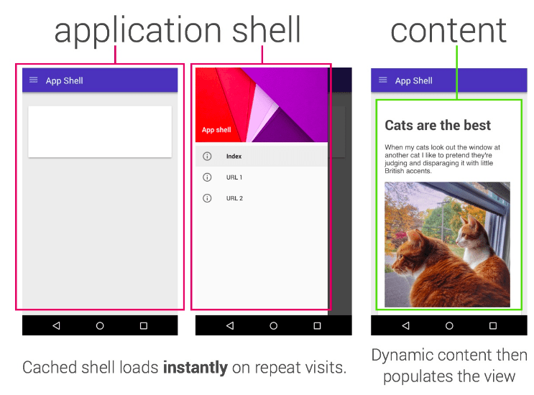

Slide 83
Service worker
Service worker is a script that browser runs in the background, completely separate from web page and don’t need user interaction
Service worker characteristic:
Can't access the DOM directly.
Service worker allowing you to control how network requests from your page are handled.
It's terminated when not in use, and restarted when it's next needed. If there is information that you need to persist and reuse across restarts, service workers do have access to the IndexedDB API.
Service workers make extensive use of promises

Slide 84
Command to install service worker
ng add @angular/pwa --project <name of project as in angular.json>

Slide 85
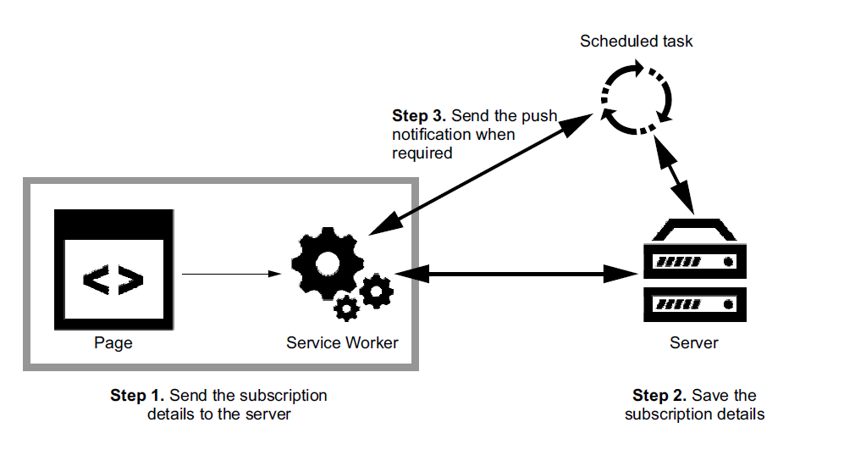
PUSH NOTIFICATION

Slide 86
VAPID protocol: is short for Voluntary Application Server Identification. It’s a specification that defines a handshake between your app server and the push service and allows the push service to confirm which site is sending messages.
Push Notification Implementation step:
Adding the client side logic to subscribe a user to push (i.e. the JavaScript and UI in your web app that registers a user to push messages).
The API call from your back-end / application that triggers a push message to a user's device.
The service worker JavaScript file that will receive a "push event" when the push arrives on the device. It's in this JavaScript that you'll be able to show a notification.

Slide 87
Useful resource to build pwa with angular cli
https://blog.angular-university.io/angular-app-shell/
https://blog.angular-university.io/angular-service-worker/
https://blog.angular-university.io/angular-push-notifications/

